Slide 1
COMP 110/L Lecture 21
Maryam Jalali Slides adapted from Dr. Kyle Dewey

Slide 2
Outline
this
instanceof
Casting
equals()
protected
interface

Slide 3
this

Slide 4
this
Refers to whatever instance the given instance method is called on.
Is a reference variable that refers to the current object.
Notes:
https://www.geeksforgeeks.org/this-reference-in-java/

Slide 5
this
Refers to whatever instance the given instance method is called on.
public class Foo {
public Foo returnMyself() { return this;
}
}

Slide 6
Example:
ThisExample.java

Slide 7
Name Clashes
this can be used to refer to instance variables which have the same name as normal variables

Slide 8
Name Clashes
this can be used to refer to instance variables which have the same name as normal variables
public class NameClash { private int x;
public NameClash(int x) { this.x = x;
}
}

Slide 9
Example:
NameClash.java

Slide 10
instanceof

Slide 11
instanceof
Returns a boolean indicating if a given instance was made from or inherited from a given class

Slide 12
instanceof
Returns a boolean indicating if a given instance was made from or inherited from a given class
public class InstanceOf {
public static void main(String[] a) { InstanceOf i = new InstanceOf(); if (i instanceof InstanceOf &&
i instanceof Object) {
// code reaches this point
}
}
}
Notes:
https://www.geeksforgeeks.org/java-instanceof-and-its-applications/

Slide 13
Example:
InstanceOfExample.java

Slide 14
Casting

Slide 15
Casting
Converts a value of one type into another.
Not always possible to perform.

Slide 16
Casting
Converts a value of one type into another.
Not always possible to perform.
int myInt0 = 16.0;
int myInt1 = (int)16.0;
// myInt2 gets set to 16 int myInt2 = (int)16.5;

Slide 17
Casting
Converts a value of one type into another.
Not always possible to perform.
int myInt0 = 16.0;
Does not compile
int myInt1 = (int)16.0;
// myInt2 gets set to 16 int myInt2 = (int)16.5;

Slide 18
Casting
Converts a value of one type into another.
Not always possible to perform.
int | myInt0 | = | 16.0;
int | myInt1 | = | (int)16.0;
// myInt2 gets set to 16
int myInt2 = (int)16.5;

Slide 19
Casting
Converts a value of one type into another.
Not always possible to perform.
int myInt0 = 16.0;
int myInt1 = (int)16.0; myInt1 holds 16
// myInt2 gets set to 16
int myInt2 = (int)16.5;

Slide 20
Casting
Converts a value of one type into another.
Not always possible to perform.
int | myInt0 | = | 16.0;
int | myInt1 | = | (int)16.0;
int | myInt2 | = | (int)16.5;

Slide 21
Casting
Converts a value of one type into another.
Not always possible to perform.
int myInt0 = 16.0;
int myInt1 = (int)16.0;
int myInt2 = (int)16.5; myInt2 holds 16

Slide 22
Casting
Converts a value of one type into another.
Not always possible to perform.

Slide 23
Casting
Converts a value of one type into another.
Not always possible to perform.
public class Foo { ... }
...
Foo f = new Foo();
Notes:
I define Foo and later on I make an instance of it

Slide 24
Casting
Converts a value of one type into another.
Not always possible to perform.
public class Foo { ... }
...
Foo f = new Foo(); Object o = f;
Notes:
I can assign f to an Object, since Foo is an instance of Object

Slide 25
Casting
Converts a value of one type into another.
Not always possible to perform.
public class Foo { ... }
...
Foo f = new Foo(); Object o = f;
Foo g = o;
Notes:
But if I try to assign an object to a Foo...

Slide 26
Casting
Converts a value of one type into another.
Not always possible to perform.
public class Foo { ... }
...
Foo f = new Foo(); Object o = f;
Foo g = o;
Does not compile
Notes:
...this fails to compile, because any arbitrary Object is not necessarily a Foo

Slide 27
Casting
Converts a value of one type into another.
Not always possible to perform.
public class Foo { ... }
...
Foo f = new Foo(); Object o = f;
Foo g = (Foo)o;
Notes:
-If, however, we cast the object as a Foo...

Slide 28
Casting
Converts a value of one type into another.
Not always possible to perform.
public class Foo { ... }
...
Foo f = new Foo(); Object o = f;
Foo g = (Foo)o; Compiles and runs ok
Notes:
-...this will work, because we have performed the cast
-The cast effectively tells Java “I know what I’m doing, and this Object is a Foo”

Slide 29
Casting
Converts a value of one type into another.
Not always possible to perform.

Slide 30
Casting
Converts a value of one type into another.
Not always possible to perform.
public public | class class | Foo Bar | { { | ... ... | } }
...
Notes:
-Let’s define these two classes

Slide 31
Casting
Converts a value of one type into another.
Not always possible to perform.
public public |  | class class |  | Foo Bar | { { | ... ... | } }
...
Foo | f | = | new | Foo();
Bar | b | = | new | Bar();
Notes:
...along with these two instances

Slide 32
Casting
Converts a value of one type into another.
Not always possible to perform.
public public | class class | Foo { Bar { | ... ... | } }
...
Foo f | = new | Foo();
Bar b | = new | Bar();
f = b;

Slide 33
Casting
Converts a value of one type into another.
Not always possible to perform.
public public |  | class class |  | Foo Bar | { { | ... ... | } }
...
Foo | f | = | new | Foo();
Bar | b | = | new | Bar();
f = b;
Does not compile
Notes:
-Doesn’t compile, because a Bar is not a Foo

Slide 34
Casting
Converts a value of one type into another.
Not always possible to perform.
public public |  | class class |  | Foo Bar | { { | ... ... | } }
...
Foo | f | = | new | Foo();
Bar | b | = | new | Bar();
f = (Foo)b;
Notes:
-If we instead try to cast it...

Slide 35
Casting
Converts a value of one type into another.
Not always possible to perform.
public public |  | class class |  | Foo Bar | { { | ... ... | } }
...
Foo | f | = | new | Foo();
Bar | b | = | new | Bar();
f = (Foo)b;
Compiles, but doesn’t run correctly (gives a ClassCastException)
Notes:
-If we instead try to cast it...

Slide 36
equals()

Slide 37
equals()
Used to determine if two arbitrary objects are equal.
Defined in Object.

Slide 38
equals()
Used to determine if two arbitrary objects are equal.
Defined in Object.
“foo”.equals(“foo”)
Returns true

Slide 39
equals()
Used to determine if two arbitrary objects are equal.
Defined in Object.
“foo”.equals(“foo”)
Returns true
“foo”.equals(“bar”)

Slide 40
equals()
Used to determine if two arbitrary objects are equal.
Defined in Object.
“foo”.equals(“foo”)
Returns true
“foo”.equals(“bar”)
Returns false

Slide 41
equals() vs. ==
With equals(), we test object equality, AKA deep equality
Look at the inside of the object
With ==, we test reference equality, AKA
shallow equality
Return true if two references refer to the exact same object

Slide 42
Example:
StringEquals.java
Notes:
-This example shows off the difference between reference and object equality

Slide 43
Defining Your Own
equals()
Usual pattern: see if the given thing is an instance of my class
If true, cast it to the class, and do some deep comparisons
If false, return false
Anything is possible

Slide 44
Example:
CustomEquals.java

Slide 45
protected

Slide 46
protected
Somewhere between private and public.
Like private, but subclasses can access it.

Slide 47
protected
Somewhere between private and public.
Like private, but subclasses can access it.
public class HasPrivate { private int x;
}

Slide 48
protected
Somewhere between private and public.
Like private, but subclasses can access it.
public class HasPrivate { private int x;
}
public class Sub extends HasPrivate {
...x...
}

Slide 49
protected
Somewhere between private and public.
Like private, but subclasses can access it.
public class HasPrivate { private int x;
}
public class Sub extends HasPrivate {
...x...
}
Not permitted - x is private in HasPrivate

Slide 50
protected
Somewhere between private and public.
Like private, but subclasses can access it.
public class HasPrivate { private int x;
}
public class Sub extends HasPrivate {
...x...
}
public class HasProt { protected int x;
}
public class Sub extends HasProt {
...x...
}

Slide 51
protected
Somewhere between private and public.
Like private, but subclasses can access it.
public class HasPrivate { private int x;
}
public class Sub extends HasPrivate {
...x...
}
public class HasProt { protected int x;
}
public class Sub extends HasProt {
...x...
OK: Sub is a subclass of HasProt
}

Slide 52
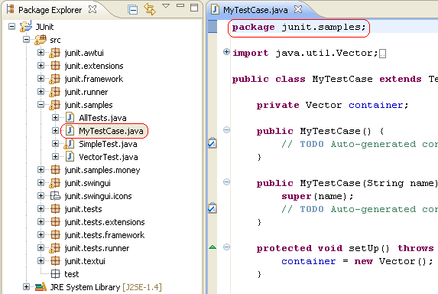
A package in Java is used to group related classes. Think of it as a folder in a file directory. We use packages to avoid name conflicts, and to write a better maintainable code.
https://www.w3schools.com/java/java_packages.asp

Slide 53
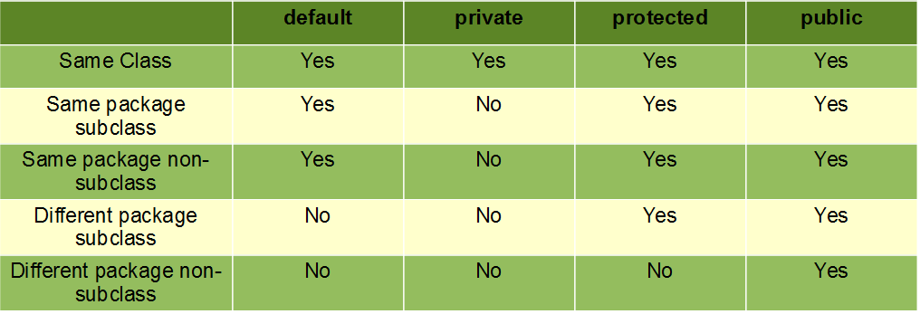
https://www.geeksforgeeks.org/access-modifiers-java/

Slide 54
interface

Slide 55




breathe
Mammal
Notes:
-We had this setup before

Slide 56



Animal
Mammal
breathe
Notes:
-Restructure: add Animal, birds, and spiders

Slide 57


Animal
Mammal
breathe
Notes:
-Restructure: add Animal, birds, and spiders

Slide 58

Animal
Mammal
breathe
Notes:
-Restructure: add Animal, birds, and spiders
-Now we have a problem: birds breathe too, but they aren’t mammals
-The property of breathing is not unique to mammals
-Potential solution: restructure things to add BreathingAnimals in between Animal and Mammal; have Birds inherit from BreathingAnimals but not Mammal.
-That solution is specific to this case; doesn’t work in general

Slide 59
interface
Like an abstract class with the following restrictions:
Cannot have constructors
Cannot have instance variables
However, we can inherit from them anywhere, and we can inherit from multiple interfaces

Slide 60
Using interfaces
public interface CanBreathe { public void breathe();
}
Notes:
-We can define an interface like so...

Slide 61
Using interfaces
public interface CanBreathe { public void breathe();
}
public class Foo extends Bar implements CanBreathe {
public void breathe() { ... }
}
Notes:
-And implement it like this
-We can extend a class along with implementing an interface

Slide 62
Using interfaces
public interface CanBreathe { public void breathe();
}
public class Foo extends Bar implements CanBreathe {
public void breathe() { ... }
}
public class Multi extends Alpha implements Beta, Gamma, Delta { ... }
Notes:
-Can inherit from multiple interfaces, separated with commas

Slide 63
Example
Animal.java
CanBreathe.java
Mammal.java
Dog.java
Cat.java
CanFly.java
Parrot.java
Bat.java
Spider.java
AnimalMain.java

